Slide 1
CAS 764 Advanced Topics in Data Management Project report Introduction of Dbsync engine
With data quality checking
Presenter: Erik Wang

Slide 2
Agenda
Project background
dbsync engine
Data quality module
Experiments
Future work

Slide 3
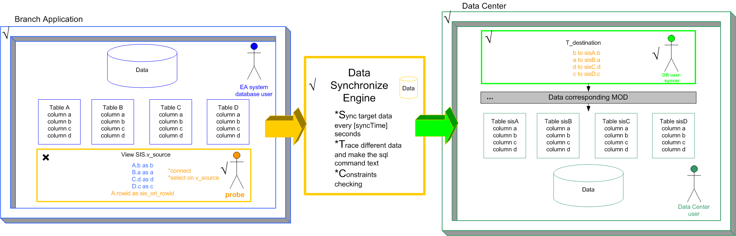
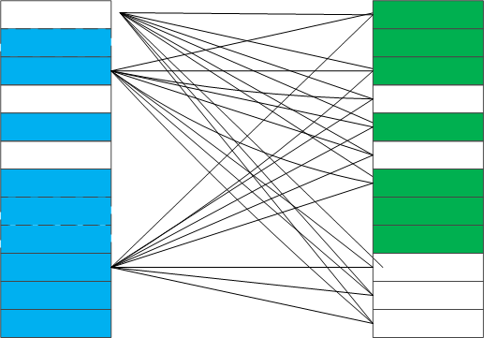
Challenge
Refersh everyday data to data center DB
Find data contents changes
All data operations can be traceable
Target data size – million level
As fast as possible
Lower database workload
(new) Support data cleaning
Cross check ?

Slide 4
Agenda
Project background
dbsync engine
Data quality module
Experiments
Future work

Slide 5
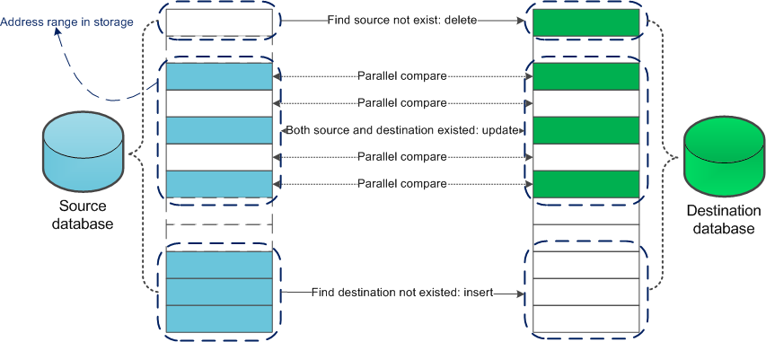
Fast Comparison
Use space to trade for time
1. Make cross-check to parallel-check
2. Partition
Notes:
Hardware price is lower but people effort is higher

Slide 6

Tradition SQL methods VS dbsync
Factor | Traditional SQL | dbsync engine
Method | Cross check | Partition + Parallel
Worst case – cross checking e.g. 3 million size | 3m * 3m = 9.0e+18 | One time comparing | 3.0e+9
 |  | Partition | (3m/k)²+k
Residential | Run on one of the databases | Either side of databases, or a 3rd party box
Workload to database instance | Heavy | Lighter (select from single side)
Compare each attributes | No, or very complex PL/SQL | Yes, user define
Generate support SQL | No | Can generate Insert/Delete/Update, and repairing suggestions
Support data quality check | No, or very complex PL/SQL | Yes, conditional check, CFD
Traceable / Logging | Yes, by DBMSs level logging | Yes, logs to file system, database, user interface
Schedule run / Batch run | Yes, implement on DBMS | Yes, user define
Expansibility | Bad | Good
Notes:
Exponential to subexponetial level

Slide 7
Synchronization Engine
Data Synchronization Engine
JAVA /JDK 6 or 7 / OJDBC6
Database – Oracle 8,9,10,11 (12 not test yet)
√ Oracle
√ Oracle
Data Executing Module
Data Comparison Module
Data Quality Module
√ Conditional Check
√ CFD
√ Database
Logging Module
√ File System
√ User interface
Synchronization Engine

Slide 8
Agenda
Project background
dbsync engine
Data quality module
Experiments
Future work

Slide 9
Data quality modules
Conditional checking
<FD>
<FID>1</FID>
<FATTR>VALUE</FATTR>
<FOPER>great</FOPER>
<FVALUE>2000.05</FVALUE>
</FD>
If values greater than 2000.05, then do something

Slide 10
Data quality modules
Conditional Functional Dependency
public class ConditionalFunctionalDependency {
private int cfdsn;
private String[] units;
private boolean CFDAUTOCLEAN;
private boolean CFDSUGGESTSQL;
private Vector<String[]> LHS;
private Vector<String[]> RHS;
…
}
MEASURENAME, BLDG → NAME,CAMPUS
--------------------------------------------------------------------------
“XRAY CHILLED WATER”, “ABB_HX” → “XRAYWT”, “MCMASTER2”
CFD data object
Measure name
bldg
name
campus
XRAYCHILLEDWATER
AAB_HX
XRAYWT
MCMASTER2
name
bldg
measure name
campus
…
DB
…
…
…
…
…
TUPLES data object

Slide 11
Agenda
Project background
dbsync engine
Data quality module
Experiments
Future work

Slide 12
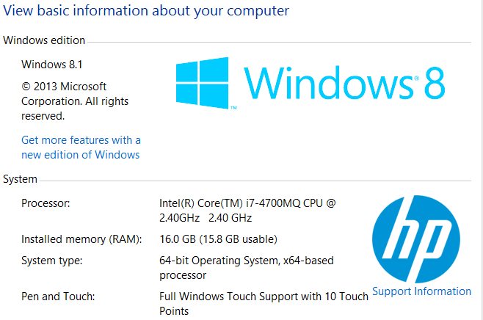
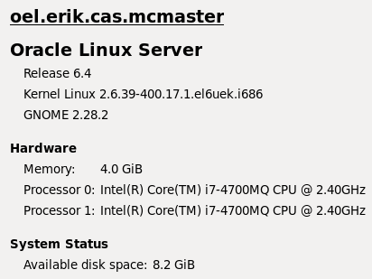
Experiment preparations – HW/SW
Running on my laptop
dbsync – Windows8.1, X64
JDK 7
Database
VMWARE workstation 9
Oracle Enterprise Linux 32bit
Oracle 11G R2

Slide 13
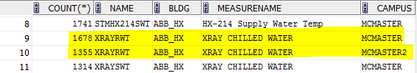
Experiment preparations – data source
Data source – Pandb
Select count(*) from pandb → 3,211,168
Data clean – remove all spaces after value
select bldg from pandb for update
update pandb.pandb set bldg = trim(bldg)
Find CFD examples
SELECT count(*),name,bldg,measurename from pandb GROUP BY pandb.NAME,bldg,measurename order by BLDG
For build CFD, add attribute – CAMPUS
update pandb set campus = 'MCMASTER2' where measurename = 'XRAY CHILLED WATER' and bldg = 'ABB_HX' and value > 20

Slide 14
Testing CFD
<CFD>
<CFDSUGGESTSQL>YES</CFDSUGGESTSQL>
<CFDAUTOCLEAN>NO</CFDAUTOCLEAN>
<CFDID>1</CFDID>
<CLHS>
<CLATTR>MEASURENAME</CLATTR>
<CLATTR>BLDG</CLATTR>
<CLVALUE>XRAY CHILLED WATER</CLVALUE>
<CLVALUE>ABB_HX</CLVALUE>
</CLHS>
<CRHS>
<CRATTR>NAME</CRATTR>
<CRATTR>CAMPUS</CRATTR>
<CRVALUE>XRAYRWT</CRVALUE>
<CRVALUE>MCMASTER2</CRVALUE>
</CRHS>
</CFD>
Testing CFD:
MEASURENAME, BLDG → NAME,CAMPUS
--------------------------------------------------------------------------
“XRAY CHILLED WATER”, “ABB_HX” → “XRAYWT”, “MCMASTER2”
Satisfied CFD
select count(*) from pandb
where measurename = 'XRAY CHILLED WATER‘ and bldg = 'ABB_HX‘
and name = 'XRAYRWT' and campus ='MCMASTER2‘
Count(*) = 1355
Violated CFD
LHS | Name | Campus | Count 1.6m | Count 3.2m
√ | × | √ | 355 | 355
√ | √ | × | 22909 | 47173
√ | × | √ | 12997 | 26349
Total | - | - | 36261 | 73877

Slide 15
CFD test accuracy result
[Engine] End of 17 of 17
[Summary] Matched :1605584 | Insert :0 | Delete:0 | Update:0 | CFD M/V:1355/36
1 |SQL Produce/Execute/Logged:0/0/0
[Engine]__________________ End of Phase 3 __________________
[Engine] ==== Phase 4:The summary.==========================
[Engine] ==== Job Start @Wed Nov 27 16:18:17 EST 2013
[Engine] ==== Job finished @Wed Nov 27 16:27:43 EST 2013
[Engine] See log file @.\dbsync\logs\pandbSYNC_1311331_1611274.txt
[Sum] Matched times:1605584 times.
[Sum] Insert action:0 times.
[Sum] Delete action:0 times.
[Sum] Update action:0 times.
[Sum] Number of producted sql command:0
[Sum] Number of executed sql command:0
[Sum] Number of logged sql command:0
[Sum] Number of CFD match:1355
[Sum] Number of CFD violate:36261
[Engine]__________________ End of Phase 5 __________________
[Engine] All done! Good bye~
Fri Oct 11 22:14:04 EDT 2013> [SQL EXECUTE] SQL Command execute: INSERT INTO PANDB.DUMP_PANDB2 VALUES('AAASz5AAIAAAAFbAAu',SYSDATE,144115188166819760,null ,'24:01.0','SF10PHT','ABB_SF','SF10 PRE-HEAT TEMP','18.4')
Match to expectation
Wed Nov 27 16:27:23 EST 2013> [CFD cleaning] UPDATE PANDB.DUMP_PANDB3 SET SIS_DES_OPTIME = SYSDATE ,NAME= 'XRAYRWT' ,CAMPUS= 'MCMASTER2' WHERE SIS_ORI_ROWID = 'AAAS10AAIAAAHYAAAb'

Slide 16
Experiment result
Test switches:
Data size 1.6m
Data size 3.2m
Constraint check ON
Constraint check OFF
Conclusion:
Constraint check doesn’t cost too much time
Block size for partition will dramatically
impact time
Time increased in linear level

Slide 17
Agenda
Project background
dbsync engine
Data quality module
Experiments
Future work

Slide 18
Future works
Support binary type data – blob (e.g. image)
Support more data quality checking/constraints/repair methods
Support private data comparison as TTP(trusted third party)
Improve data execution module’s performance

Slide 19
Thank you
Question Time

Slide 20
BACKUP SLIDES

Slide 21
Item | Data Set 1 | Data Set 2 | Increasing %
# of total tuplus | 200698 | 1605584 | 700%
CFD Satisfied | 1355 | 1355 | 0
CFD Violated | 3347 | 36261
Running time (sec) | 29 | 443

Slide 22
# of tuples | CFD Satisfied | CFD Violated | Running time (sec) CFD | NO CFD | Block size
200698 | 1355 | 3347 | 29 sec
1605584 | 1355 | 36261 | 6’1 | 4’53 | 300000
1605584 | 1355 | 36261 | 5’40 | 4’38 | 250000
1605584 | 1355 | 36261 | 5’35 | 4’35 | 150000
1605584 | 1355 | 36261 | 6’00 | 4’54 | 125000
1605584 | 1355 | 36261 | 6’24 | 5’02 | 110000
1605584 | 1355 | 36261 | 6’16 | 5’18 | 100000
1605584 | 1355 | 36261 | - | 5’53 | 80000
1605584 | 1355 | 36261 | - | 7’47 | 50000
3211168 | 1355 | 73877 | 11’35 | 11’19 / 9’22 | 150000
 |  |  | 11’19 | 9’1 | 250000
 |  |  | 11’29 | 10’57 / 11’19 | 300000
 |  |  | 11’37 | 9’38 | 125000
 |  |  | 15’57 | 13’26 | 110000

Slide 23
K | Block | Seconds
1000 | 201 | 122
2000 | 101 | 76
5000 | 41 | 44
10000 | 21 | 33
15000 | 14 | 29
30000 | 7 | 27
50000 | 5 | 29
80000 | 3 | 29
100000 | 3 | 33
200000 | 2 | 50
300000 | 1 | 49

